Slide 1

MOS
Matthias Puchner, Moritz Famira,
Julian Meyringer, Anton Schubhart

Slide 2

Description
Mos is an online merchandise shop where you can upload design and create own unique shirts, hoodies caps, mugs and mousepads
Additionally there is a voting system where users can vote on the designs that will be used for the merch.

Slide 3
Time Management
Expectation
Reality
Frontend: 24h
Backend: 30h
Planning: 40h
Research: 36h
Total: 130h
Frontend: 79,75h
Backend: 33,5h
Planning: 23,25h
Research: 2h
Total: 138,5
+ 18h Documentation not included in estimate

Slide 4
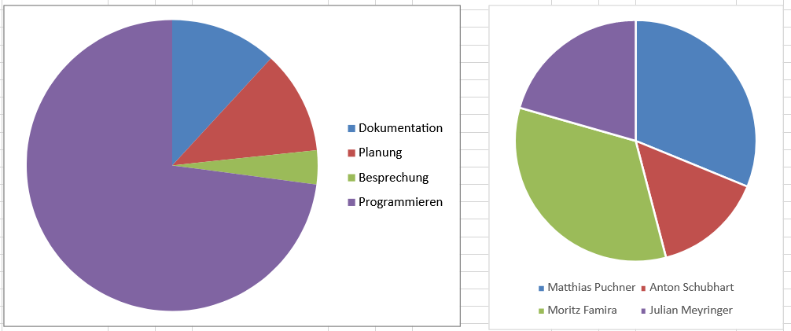
Time Split

Slide 5
Work Split
Anton Schubhart:
Mainpage, theme changer, login page, MOS logo, Footer
Matthias Puchner:
Navbar, Product page & function, Cart page & function, MOS logo, Drag and Drop, Login & Register function, theme changer
Julian Meyringer:
Backend: Products, Delete Controller, Get Controller, Post Controller, Database
Frontend: About Us Page, Register Page, Voting Page, Drag and Drop
Moritz Famira
Backend for everything except Products
Connecting Front and Backend (JS Queries)

Slide 6
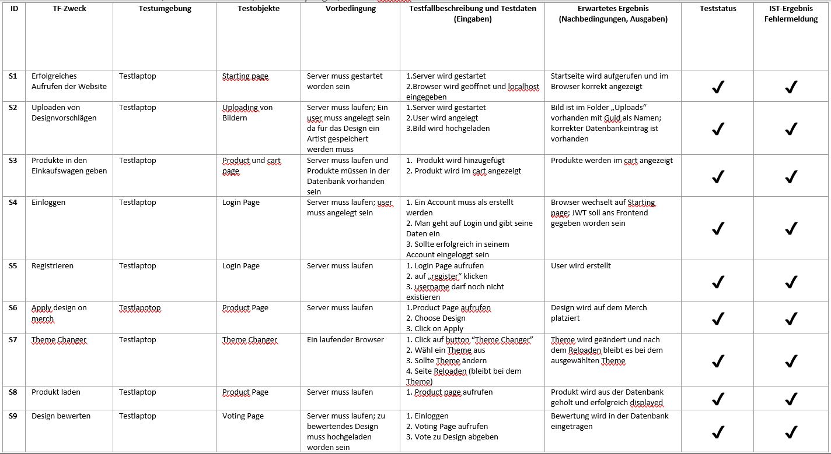
Test Cases

Slide 7
Presentation of our Website

